Slide 1
Denial of Service Attack Lab
Lab contributions from
Dr. John Guo, James Madison University

Slide 2
DoS Attack Lab
Materials needed
Kali Linux Virtual Machine
Windows 7 Virtual Machine
Software Tool used
Metasploit (Pre-installed tool on Kali Linux)

Slide 3
Objectives Covered
Security+ Objectives (SY0-601)
Objective 1.4 – Compare and contrast types of attacks
Application/Service Attacks
Denial of Service
DHS CAE Units
CTH – Describe different types of attacks and their characteristics

Slide 4
What is a DoS Attack?
A Denial of Service (DoS) attack is when a system is rendered unusable [denying users the service of the system]
For example, suppose you are a Google server that’s taking questions from two friends (Bob and Sally)
Bob is firing off question after question "What's today?" nonstop without ever pausing to listen for a reply from you
Sally is asking one simple question, “In what city is the Guggenheim located?”
You are unable to handle Sally’s request because you are stuck listening to Bob’s questions
This is a simple example of how a DoS attack works

Slide 5
Setup Environments
Log into your range
Open the Kali Linux and Windows 7 Environments
You should be on your Kali Linux Desktop
You should also be on your Windows 7 Desktop

Slide 6
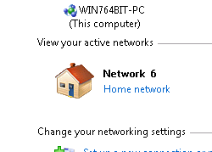
Setup Environments
Change your network location
Click on the Windows Start button
Search for “Network”
Open the Network and Sharing Center program
Under you Network #, click on the “Public Network”
Select the “Home Network” option
This disables the Windows Firewall and allows the attack.

Slide 7

Find the IP Address (Kali Machine)
You will need the IP address of the Kali machine
Open the Terminal
In the Linux VM, open the Terminal and type the following command:
hostname -I
This will display the IP Address
Write down the Kali VM IP address
The IP Address

Slide 8
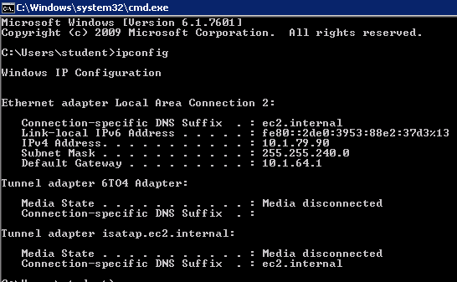
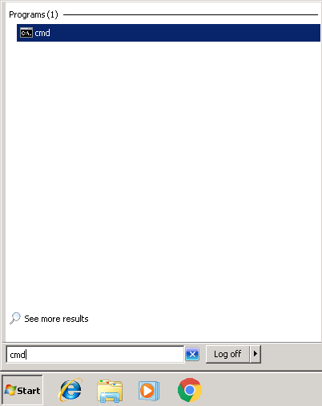
Find the IP Address (Windows)
Select the Start button (Windows Machine) and search for “cmd”
Open cmd (Command Prompt)
Use the following command:
ipconfig
Search for the IPv4 Address line
Write down the Windows IP Address
Windows IP Address

Slide 9

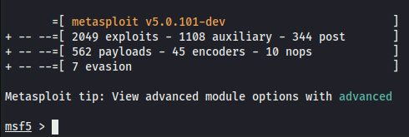
Start Metasploit
Start Metasploit:
sudo msfconsole
You should see Metasploit launch!
You should notice msf5 >

Slide 10
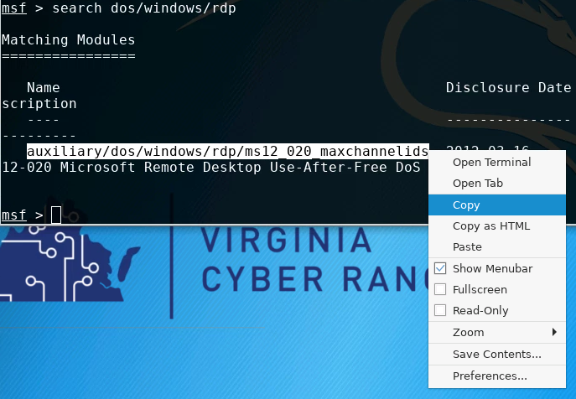

Find the DoS Tool
Search for the attack:
search dos/windows/rdp
Highlight and copy the name of the attack
Use the following command to open the attack (paste the name):
use auxiliary/dos/windows/rdp/ms12_020_maxchannelids

Slide 11
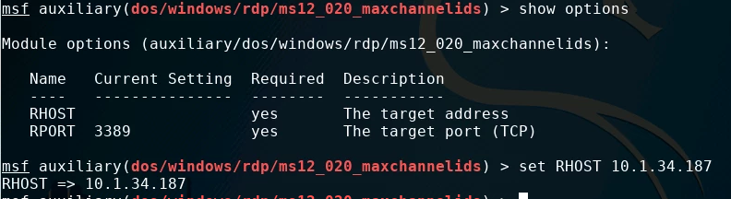
Change Attack Settings
Show the options for the attack
show options
Set the RHOST Address
set RHOST Windows_IP_Address
This is the IP Address of the target

Slide 12
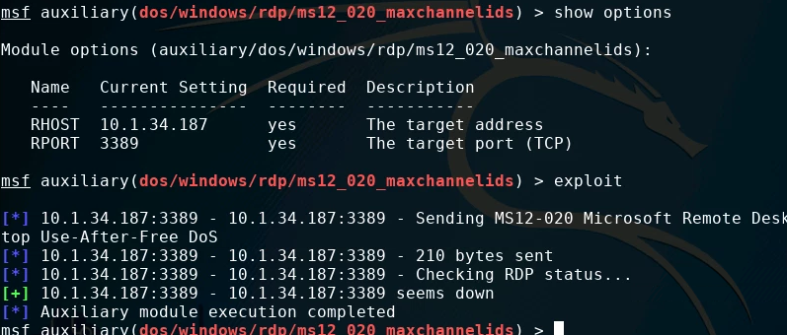
Launch the Attack
Make sure the RHOST is correct [RHOST = remote host]
show options
Verify the RHOST is set to the Windows IP Address
Launch the attack
exploit

Slide 13
Playing the Victim
Go to the Windows VM
Try and open an application
Are you able to do anything in the Windows VM?
The Windows system should effectively be shut down by the attack

Slide 14
How to Defend Against a DoS Attack?
Use firewalls!
Remember that we shut the firewall down by setting the network to a home network at the start of this lab
Update your systems
Remember to update your OS to stay up to date with security/firewalls
What are some other ways of defending against a brute force attack?

